Slide 1
MIPS Processor Project Presentation
ECE 4120/5120 - Spring 2025
Team: Matthew Collins & Lewis Bates
Emails: mcollins42@tntech.edu & lfbates42@tntech.edu

Slide 2
Final Working Project
Achievement: Successfully implemented a single cycle processor (Fig. 1) and a pipelined MIPS processor (Fig. 2), with the exception to a data memory error. We attempted the Bonus Pipeline processor with Forwarding and Hazard Units (Fig. 3); When tested, there were errors present.
Details:
Integrated all three phases for a complete single-cycle implementation (Fig. 1).
Integrated all three phases for a simple pipelined architecture (Fig. 2).
Added bonus features: forwarding unit for data hazards and hazard unit for load-use hazards (Fig. 3).
Outcome: Demonstrated correct execution of instructions in single-cycle and pipelined versions apart from an error in the data memory. In the bonus part, there seemed to be additional errors with stalling and forwarding.

Slide 3
Initialization and Setup (Simple Pipelined Version)
Register Values:
Method: Loaded using addi instructions via the test bench.
Values: $t1 = 1, $t2 = 2, $t3 = 3, $t4 = 4.
Rationale: Chosen to create data dependencies and test the functionality of the design.
Data Memories:
The data memory was not initialized for the Simple Pipelined version.
Instruction Memories:
Method: Used the test bench to load the instruction memory with machine code.
Instructions:
beq $t1, $t2, Equal (000100 01001 01010 0000000000000100)
add $t1, $t1, $t2 (00000001001010100100100000100000)
sw $t3, 100($t2) (10101101010010110000000001100100)
or $t1, $t4, $t2 (00000001100010100100100000100101)
Equal (00000000000000000000000000000000)
Rationale: The instructions need to be in the memory in order to be executed and their execution tests the functionality of the design.

Slide 4
Single Cycle Implementation Results
Key Results:
beq $t1, $t2, Equal: Not taken ($t1 = 1, $t2 = 2, not equal).
sw $t3, 100($t2): Fails to store $t3 = 3 into memory[102].
Verification:
ALU zero flag = 0 for beq.
Data memory output does not show memory[102] = 3.
Screenshots: Waveform from ModelSim-Altera showing single-cycle execution, highlighting beq and sw memory update.

Slide 5
Pipelined Implementation Results
Key Results:
Demonstrated pipelining across fourth, fifth, and sixth clock cycles.
Cycle 4: beq $t1, $t2, Equal ALU output completes as -1.
Cycle 5: add $t1, $t1, $t2 ALU output completes as 3.
Cycle 6: sw $t3, 100($t2)address completes at ALU output as 102.
Verification:
ALU outputs are the expected values
Screenshots: Waveforms show the ALU output of the first three test instructions.

Slide 6
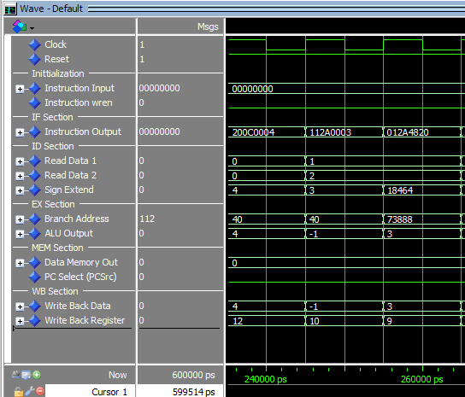
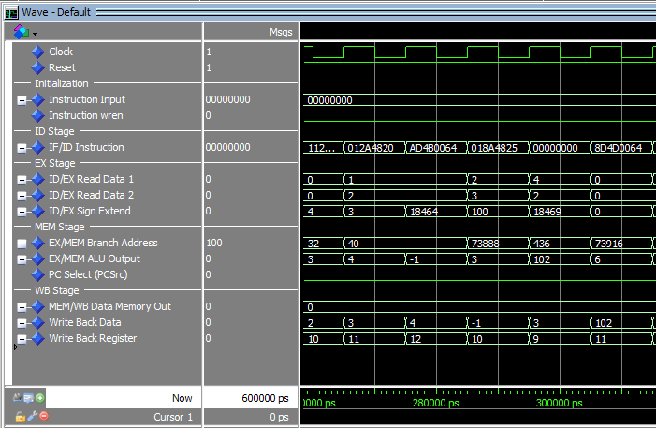
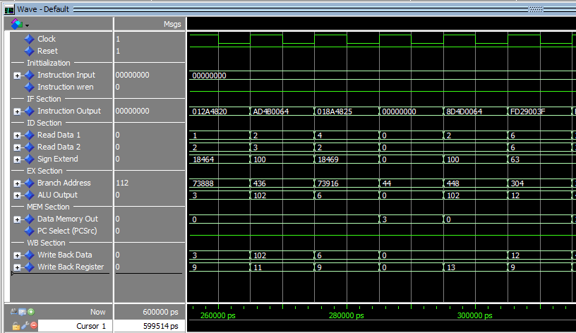
ModelSim Waveforms
Single-Cycle Version
Simple Pipelined Version
beq $t1, $t2, Equal
Cycles 4-6 of Pipelined Version
sw #t3, 100($t2)
lw $t5, 100($t2)

Slide 7
Demonstration Notes
Tool: ModelSim-Altera.
Waveforms:
Single cycle: Show beq and sw.
Pipelined: Show cycles 4-6.
Preparation: Waveforms pre-loaded on laptop for immediate display post-presentation.

